Slide 1
HACKERRANK PROGRAMS
-Anika.M.B
Bsc.cs(AI)

Slide 2
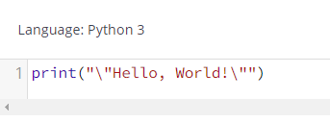
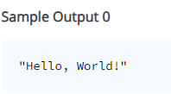
Input & Output-Say “Hello, World!”

Slide 3
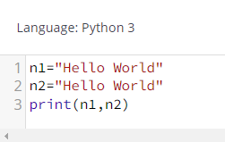

Input & Output-Hello world with tab

Slide 4
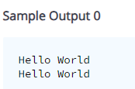
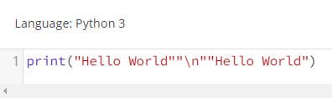
Input & Output-Hello World with a new line

Slide 5
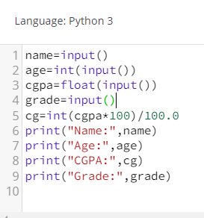
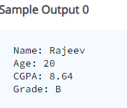
Input & Output - Student Details

Slide 6
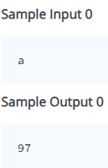
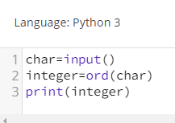
Input & Output - ASCII Values - I

Slide 7
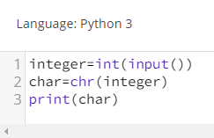
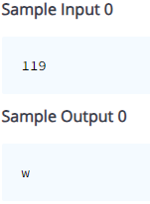
Input & Output - ASCII Values - II

Slide 8
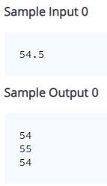
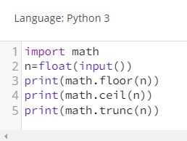
Input & Output - Round Off

Slide 9
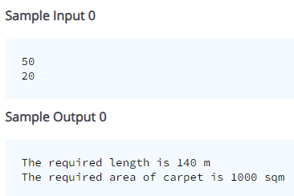
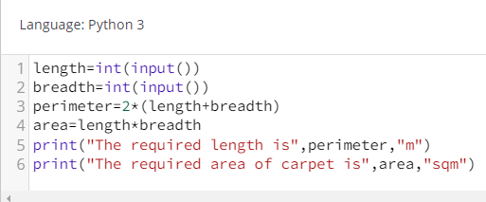
Operators - Fencing the Ground

Slide 10
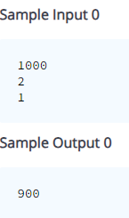
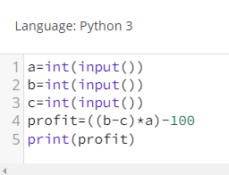
Operators – The Newspaper Agency

Slide 11
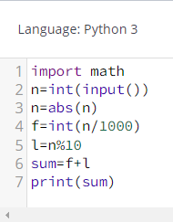
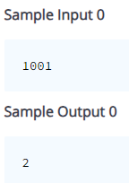
Operators – Harry Potter

Slide 12
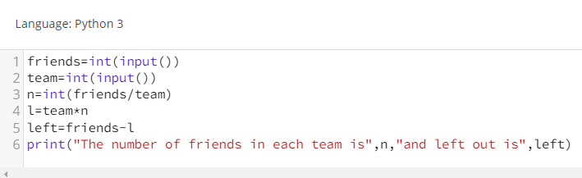
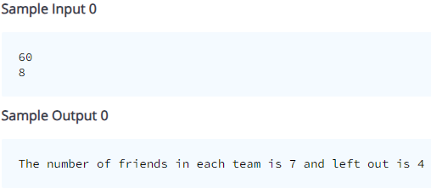
Operators – Splitting into the teams

Slide 13
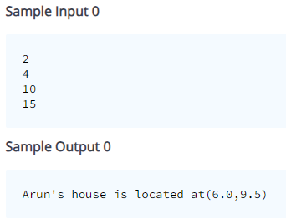
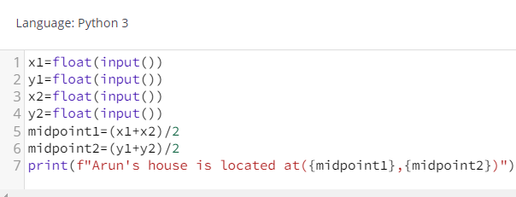
Operators – 3 Psychos

Slide 14
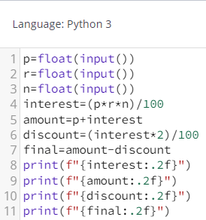
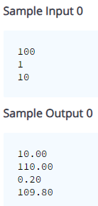
Operators – Debt Repay

Slide 15
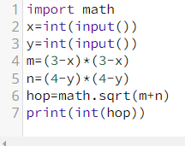
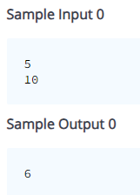
Operators – Hop n Hop

Slide 16
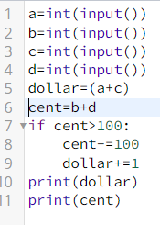
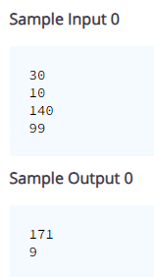
Operators – Dollars & Cents

Slide 17
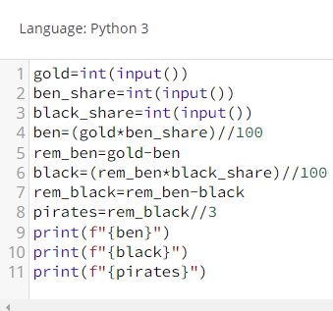
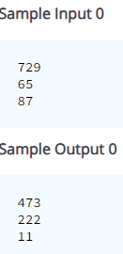
Operators – Treasure Hunter

Slide 18
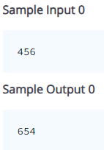
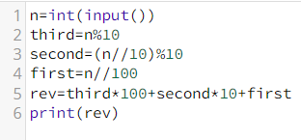
Operators – Reverse a 3-digit number

Slide 19
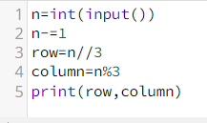
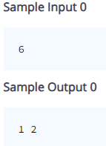
Operators – Tic Tac Toe

Slide 20
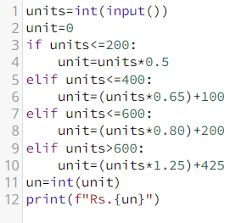
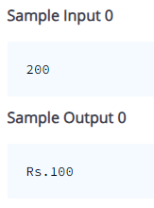
Decision Making – Electricity Bill

Slide 21
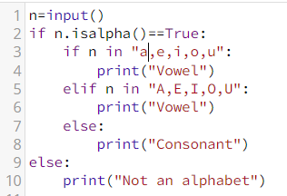
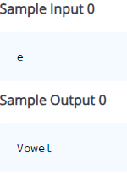
Decision Making – Checking Alphabet

Slide 22
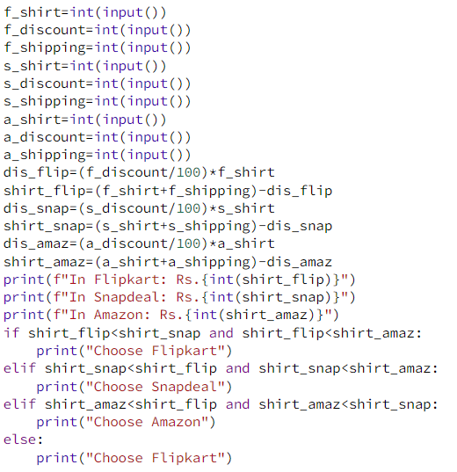
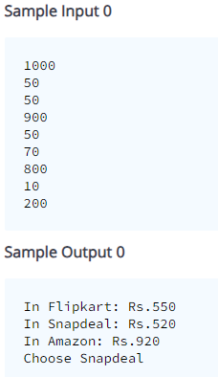
Decision Making – Online Shopping

Slide 23
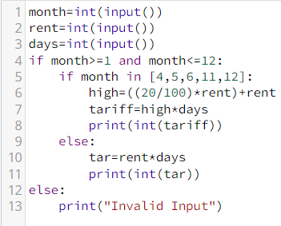
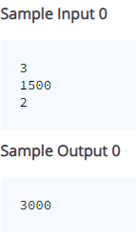
Decision Making – Hotel Tarrif Calc

Slide 24
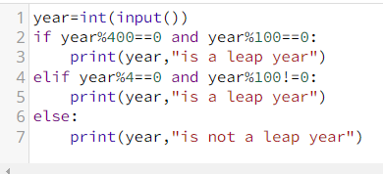
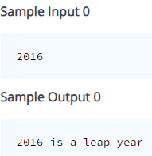
Decision Making – Gift for Birthday

Slide 25
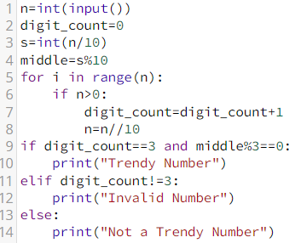
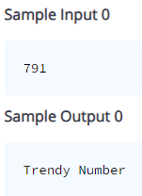
Decision Making – Trendy Number

Slide 26
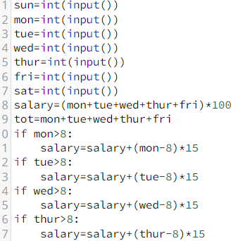
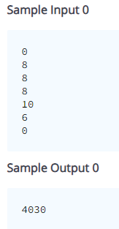
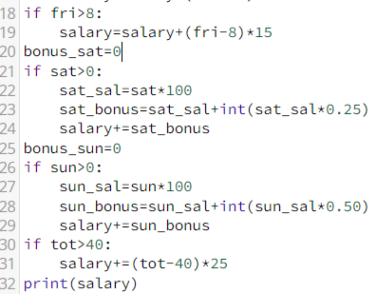
Time Sheet

Slide 27


Decision Making – Mango Tree

Slide 28


Decision Making – Cricket

Slide 29


Decision Making – Number of days

Slide 30


Decision Making – Scholarship

Slide 31


Control Statements – Multiplication Table

Slide 32


Control Statements – Print Prime numbers in a range

Slide 33


Control Statements – Special Numbers

Slide 34


Control Statements – Amoeba Multiplication

Slide 35


Control Statements – Number Series

Slide 36


Control Statements – Hollow square

Slide 37


Control Statements – Treasure Finder

Slide 38


Control Statements – Collatz Problem

Slide 39


Control Statements – Strong Number

Slide 40


Control Statements – Inverted right angled triangle

Slide 41


Control Statements – Sum of digit till single digit

Slide 42


Control Statements – Kaprekar Number

Slide 43


Control Statements – Trapezium Pattern

Slide 44


Arrays 1D – Same or Not

Slide 45


Arrays 1D – Count distinct elements

Slide 46


Arrays 1D – Compatible Array

Slide 47


Arrays 1D – Sum of odd and even numbers

Slide 48


Arrays 1D – Ascending Order

Slide 49


Arrays 1D – Queue

Slide 50


Arrays 1D – Array Insertion

Slide 51


Arrays 1D – Remove duplicate elements

